Slide 1

Virus evolution and molecular clocks

Slide 2
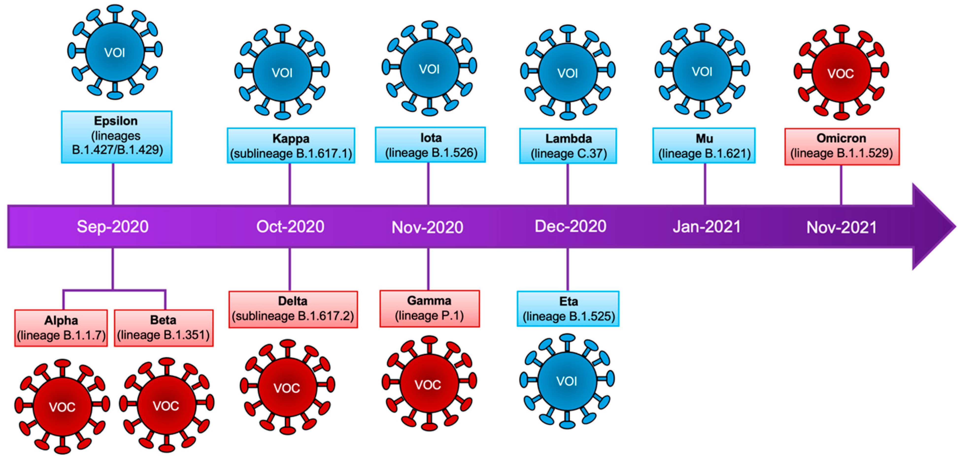
Virus evolution
Changes in the genetic sequences of viruses over time
Can occur through various mechanisms (e.g. mutation & recombination), leading to the emergence of new virus variants
Why should we care?
Flores-Vega et al., 2022
Notes:
Tracking these changes over time is crucial to inform public health strategies
If we see things evolving differently, whats the reason
Outbreaks?
In rabies, latent period long periods no evolution
Hosts – dogs, wildlife, humans etc
Long periods of sampling to get signal in rabies

Slide 3
Molecular clocks
Molecular sequence data from rapidly evolving organisms are often sampled at different points in time
Sampling times can then be used for molecular clock calibration
The root-to-tip (RTT) regression is an essential tool to assess the degree to which the data behave in a clock-like fashion
Types of molecular clocks:
Strict vs relaxed
Local vs global

Slide 4
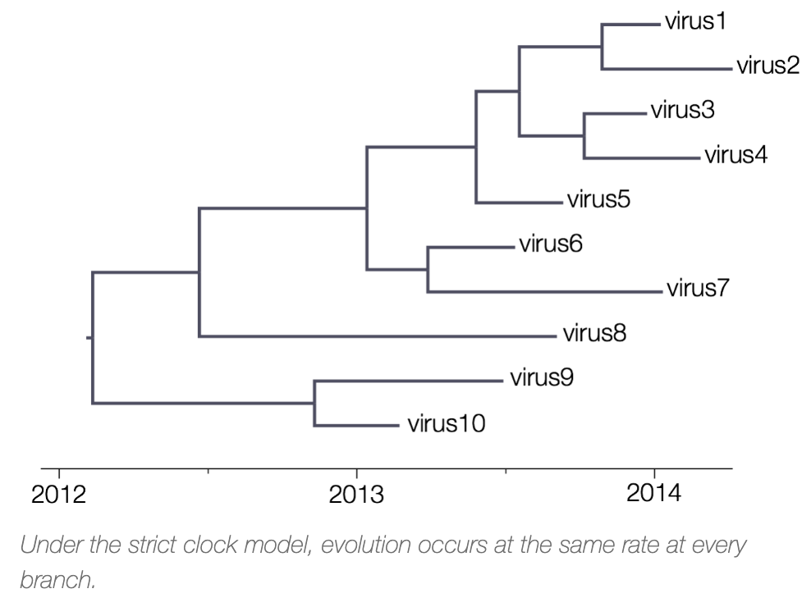
The strict molecular clock
A strict molecular clock
The simplest molecular clock model
Assumes a constant evolutionary rate (rate of substitution per unit time)
When the evolutionary rate is constant throughout a phylogenetic tree, the term global molecular clock is used
beast.community

Slide 5
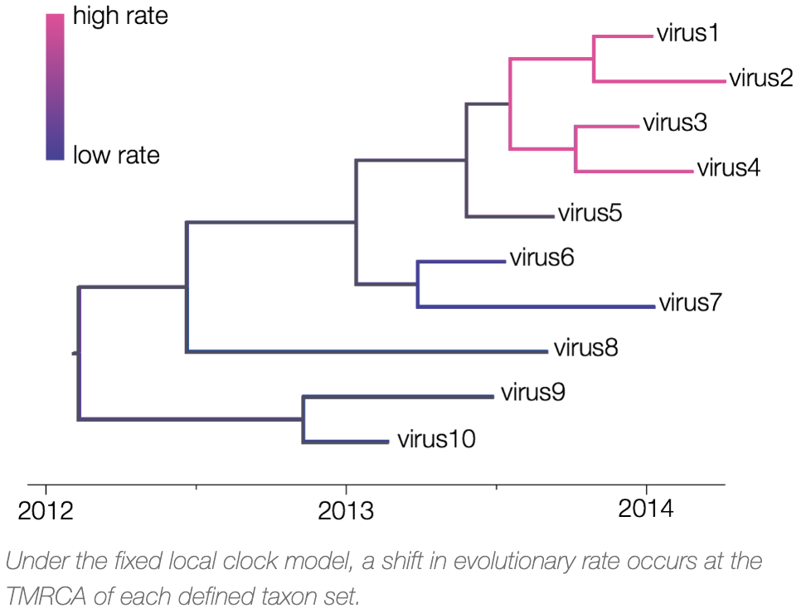
The strict molecular clock
A strict local clock - different substitution rates apply to different monophyletic groups within a tree
sampling from different host populations, host species, or pathogen lineages
Larger datasets are more likely to sample from distinct populations, making local clocks increasingly important
beast.community
Notes:
larger datasets, as a function of their size, are more likely to sample from distinct populations, making local clocks increasingly important

Slide 6
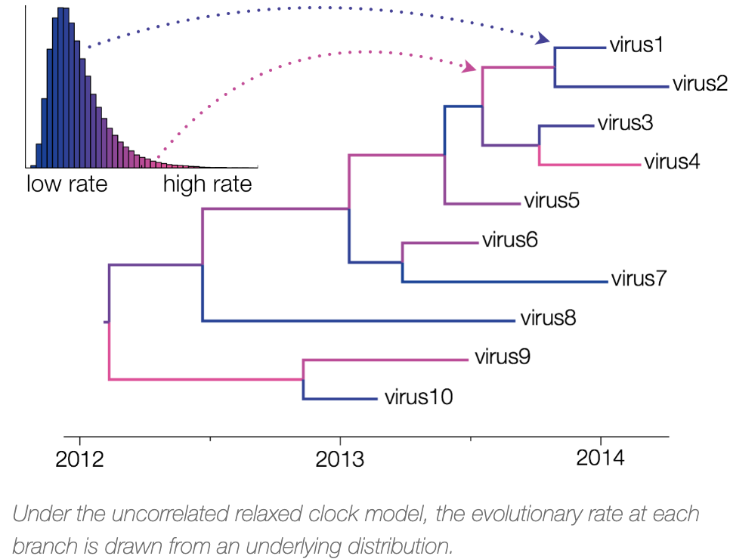
The relaxed molecular clock
Multivariate statistical approach i.e. a different rate for each branch
Computationally demanding
beast.community

Slide 7
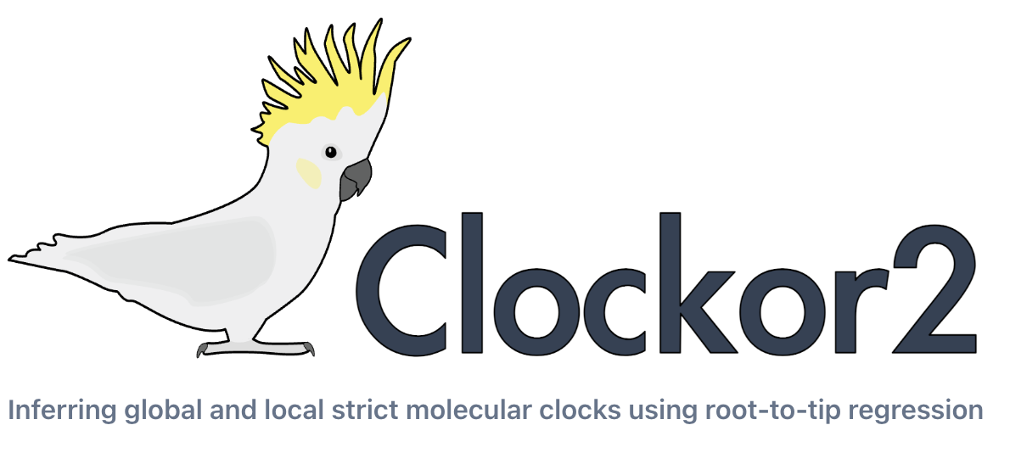
Clockor2
A scalable and accessible client-side web application for exploring the fit of local clocks, with results available in seconds to minutes
Enables rapid inference of global and local strict molecular clocks from phylogenetic trees using root-to-tip regression (RTT)
clockor2.github.io

Slide 8
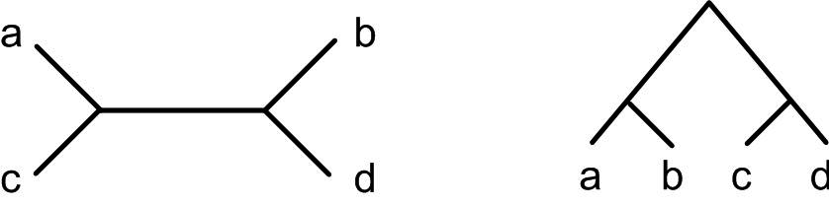
Input
A newick tree
Sampling dates & group identifiers (parsed from tip labels or separate files on input)

Slide 9
The Best Fitting Root
Based on the R² or residual mean square (RMS) of the RTT regression of a global clock model for the input tree
The root position along the branch leading to the highest R² or RMS is selected
The best-fitting root is inferred using a single global clock because it presents the most parsimonious model of the evolutionary rate for a given tree
Clockor2 does not find the best-fitting root for local clock models because the search space of best-fitting roots and local clock configurations quickly becomes prohibitive and is possibly unidentifiable
Notes:
Clockor2 does not find the best-fitting root for local clock models because the search space of best-fitting roots and local clock configurations quickly becomes prohibitive and is possibly unidentifiable

Slide 10
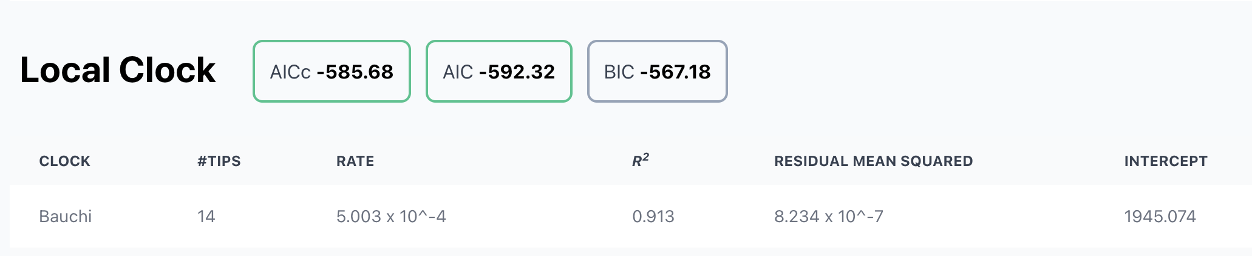
Testing the fit of a clock
Local clock and or global clock configurations can also be compared using an information criterion
Bayesian Information Criterion (BIC)
Akaike Information Criterion (AIC)
corrected Akaike Information Criterion (AICc)
Notes:
We recommend using the BIC because it most heavily penalises the addition of extra parameters, and local clocks in turn.

Slide 11



Let’s put Clockor2 to work!
#UofGWorldChangers
@UofGlasgow

